Slide 1
Learning and Memory
What Teachers Need to Know about the Human Brain
Karen Marsh Schaeffer
Director, English for Academic Success
Department of Linguistics

Slide 2
Perception
In the next three slides, I will show you some pictures.
Each picture will be different.
Just look at the pictures and see what you notice in each.

Slide 3
Meaning
From memory, jot down a few thoughts from the pictures.
Label your thoughts 1-3 to match the pictures.
When you have finished, turn to someone close to you and discuss what you wrote.
Notice the similarities or differences in your perception of the photo and any meaning you may have assigned based on that perception.
Discuss the objective details – locations, number of people, colors, objects in the photo – Do you come up with the same details?

Slide 4
What is wrong with the student?
Do you ever say to yourself…….
“I have told them a hundred times, why don’t they get it?”
“How many times do I have to say this?”
“Weren’t you paying attention to what I said?”
“Let me repeat what I said earlier.”
Notes:
It is possible the person has a learning disability, but most likely it is about connections.

Slide 5
Connections
We don’t learn from scratch
Learning occurs when tied to:
Sense
Connections
Prior knowledge
Emotion
Play
Positive Feedback
Notes:
Literally, we make connections in our brains as we learn new material. If you watch on an MRI, you can see the connections being formed.
Fire until you wire……

Slide 6
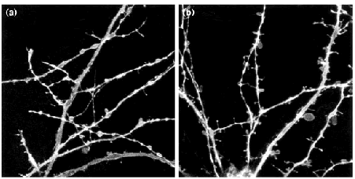
Notes:
Encoding is a biological event beginning with perception through the senses. The process of laying down a memory begins with attention (regulated by the thalamusand the frontal lobe), in which a memorable event causes neurons to fire more frequently, making the experience more intense and increasing the likelihood that the event is encoded as a memory. Emotiontends to increase attention, and the emotional element of an event is processed on an unconscious pathway in the brain leading to the amygdala. Only then are the actualsensations derived from an event processed.

Slide 7
Strong Memories
Think of a really strong memory

Slide 8
Emotions
How do emotions help with memory formation?
How do emotions inhibit memory formation?
Cognition and memory are intertwined.
Notes:
Think of a really strong memory. What makes that memory so strong?
Are there any holes in your memory? Why are there holes? What blocks that time?
What connections do the students make with us?

Slide 9
What do I Project?
Do I help a student form connections?
Do I inhibit a student forming connections?
Notes:
Clip #1 Mr. Holland’s opus youtube part 2 6mins-7:43
Clip #2 youtube part 3 1:34-2:38
Clip #3 youtube part 3 8:12-10:31

Slide 11
How can I help?
Be aware of what I project
Repeat things
Use multiple learning styles
Provide information in writing
Use university Services
Remember ‘students are learning, you are already an “expert”…..’

Slide 12
Language Learners
Language Learners are already using more of their brain that you are
Emotions that inhibit might be different from native speaker (average freshman)
The starting place for connections is different
Notes:
Emotions – survival, where can I get food that does not make me sick….., how am I going to get through this semester, I thought I was smart, but I can’t even understand the words this guy is saying.
Experience in Math not even understanding when the teacher called my name.

Slide 13
Thank You
Karen Marsh Schaeffer
Department of Linguistics
Karen.marsh@utah.edu

